Slide 1
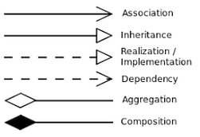
logging_
FACTORS
run
DUMMIES
Strategies
helpers
LiveTrading
ScannerBased
CashManagem.
InstrSelection
Signals
RiskManagement
Reporting
Scanners_1
SimpleMovingA.
BollingerBands
HeartbeatMonit.

